Slide 1


DieHarder: Securing the Heap
Gene Novark & Emery Berger
University of Massachusetts

Slide 2
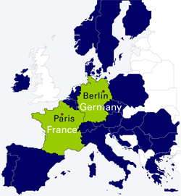

Slide 3


Slide 4


Slide 10
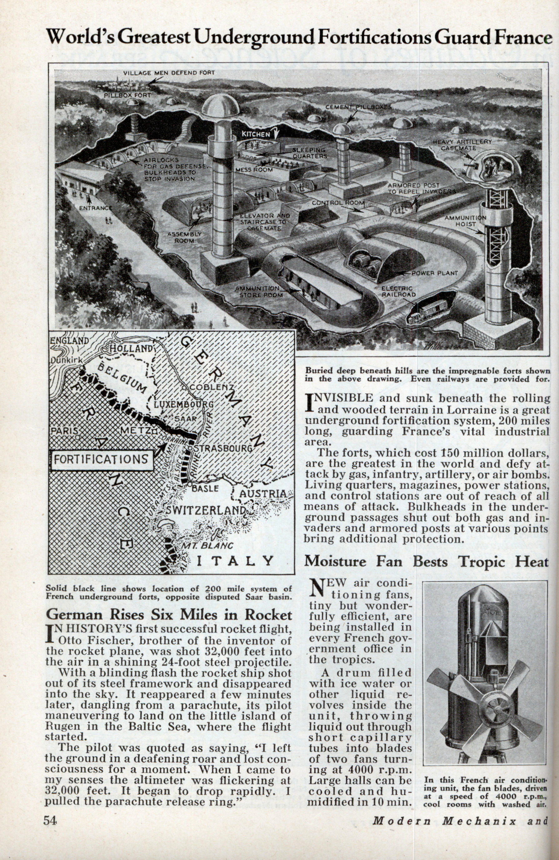

Slide 11
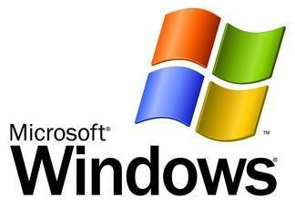
Notes:
I mean, Windows

Slide 14
Notes:
So the big question between counterattacks & the next attack is…

Slide 15
got security?

Slide 16
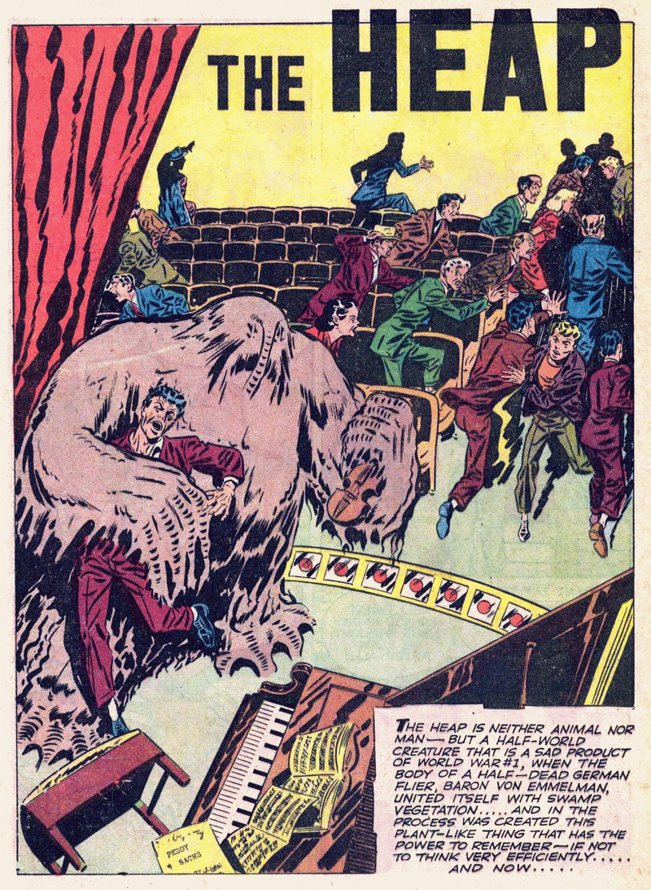
Notes:
Today we are focusing on the heap – a clear threat

Slide 17
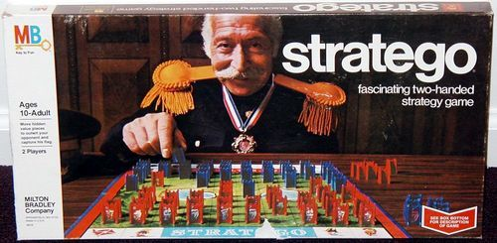
Notes:
Rather than talk technical about the heap internals - stratego

Slide 18
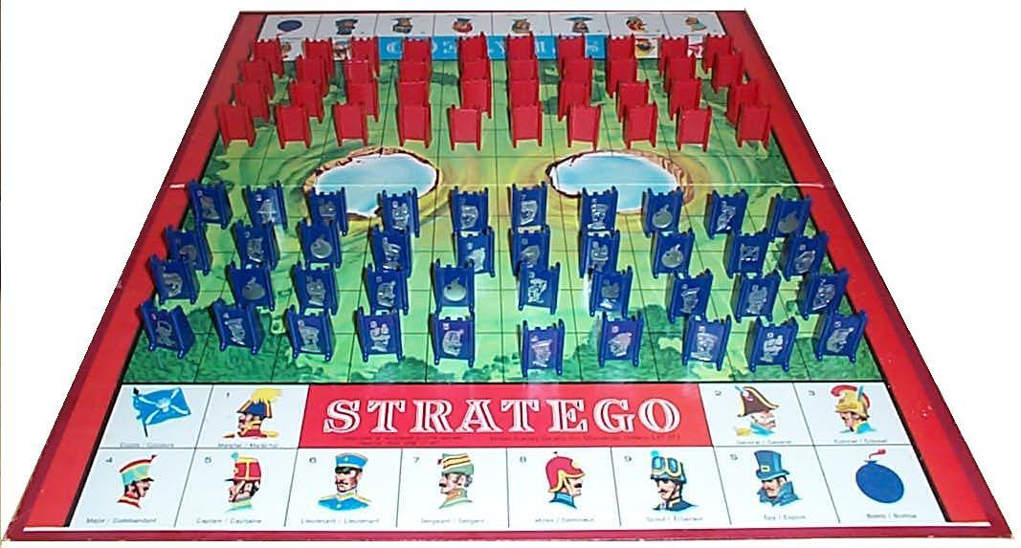
Notes:
If you haven’t played, here’s the way it works…

Slide 19
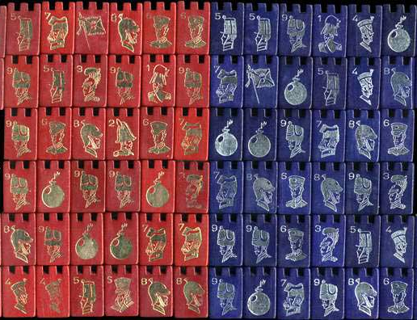
Notes:
There are lots of pieces in the original game…

Slide 20
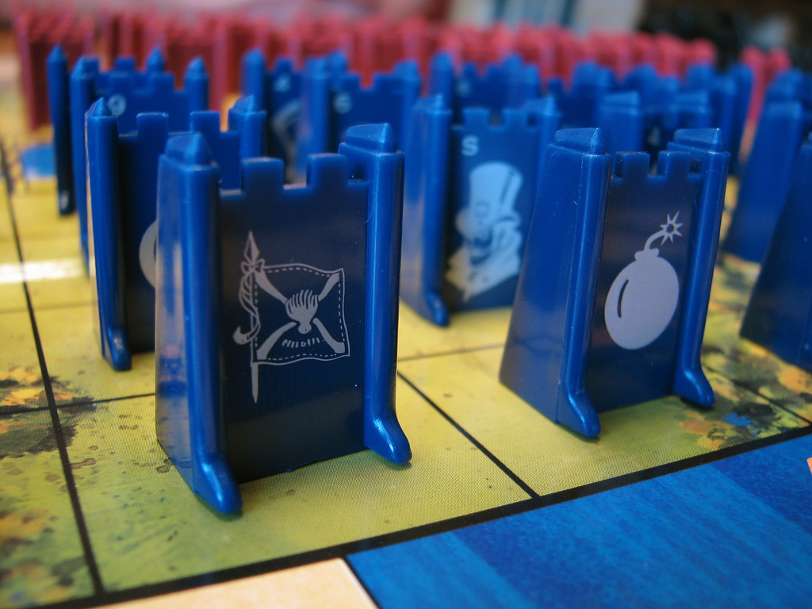
Notes:
But in this talk, we’re going to pretend that the only pieces are flags and bombs. If you hit a flag, you win. If you hit a bomb, you die.

Slide 21
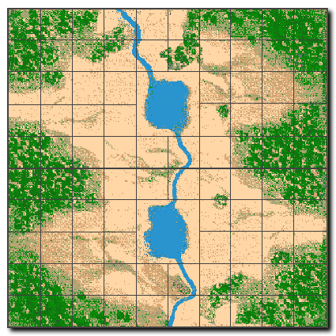
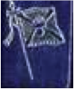
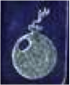
Notes:
Suppose this is the board layout.

Slide 22
Notes:
If the attacker hits the flag, …

Slide 23
Notes:
Pwned.

Slide 24
Notes:
However…

Slide 25
Notes:
If he hits the bomb...

Slide 26
Notes:
Then “the good guys” win.

Slide 27
Notes:
So to be concrete…

Slide 28
sensitive data / metadata
Notes:
The flags are sensitive data or metadata.

Slide 29
sensitive data / metadata
All data / metadata sensitive
Notes:
In our model, we assume conservatively that *all* data / metadata is sensitive.

Slide 30
guard / unmapped page
Notes:
And each bomb is either a guard page (mprotected) or an unmapped page, so a write or read into this space…

Slide 31
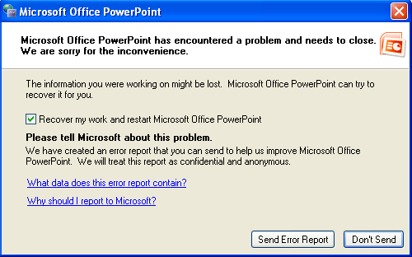
guard / unmapped page
Notes:
Does this.

Slide 32

Notes:
This is how it works for Windows

Slide 33
Notes:
This is how it works for Windows

Slide 34
Notes:
This is how it works for Windows

Slide 35
Address-space layout randomization
Notes:
This is how it works for Windows

Slide 36
object
free space
heap metadata

Slide 37
prev. object
object size
object
free space
heap metadata
(GNU libc, others)

Slide 38
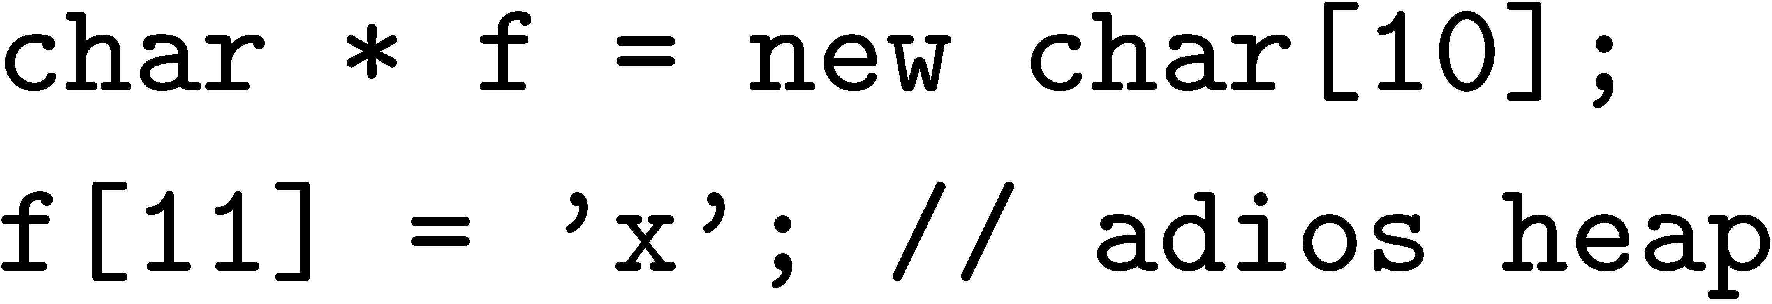
object
x
free space
heap metadata

Slide 39
object
x
free space
heap metadata

Slide 40
Notes:
This is how it works for Windows

Slide 41
Notes:
This is how it works for Windows

Slide 42
Notes:
This is how it works for Windows

Slide 43

Notes:
This is how it works for Windows

Slide 44
Notes:
This is how it works for Windows

Slide 45
Notes:
This is how it works for Windows

Slide 46
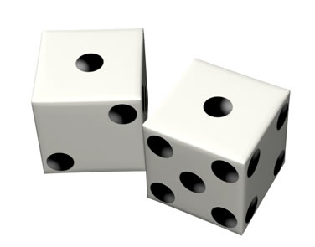
Notes:
This is how it works for Windows

Slide 47
≈ 4-5 bits of entropy
Notes:
This is how it works for Windows

Slide 48
DIE HARDER
Notes:
This is how it works for Windows

Slide 49
Maximal entropy: log N bits (e.g., ≈ 25-30)
DIE HARDER
Notes:
This is how it works for Windows

Slide 50
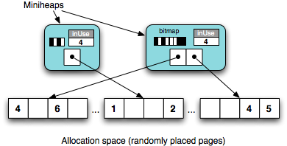

Slide 51
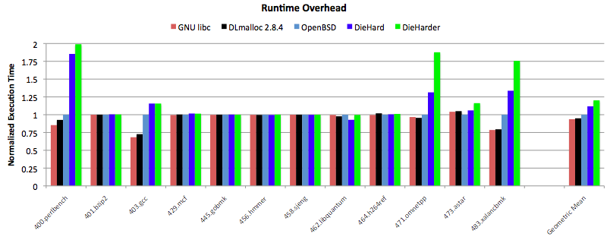

Slide 52

DIE HARDER

Slide 53
44.2 sec
DIE HARDER

Slide 54
44.2 sec
41.6 sec
DIE HARDER

Slide 55
DieHarder: Securing the Heap
Gene Novark & Emery Berger
University of Massachusetts

Slide 56
char * str = new char[8];
strcpy (str, “goodbye cruel world”);

Slide 57
int * v = new int[4];
…
delete [] v; // oops
…
char * str = new char[16];
strcpy (str, “die, pointer”);
v[3] = 12;
… use of v[0]

Slide 58
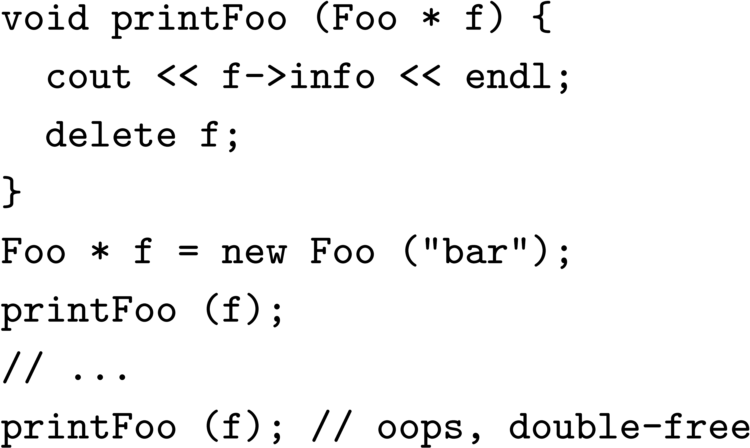
Double free

Slide 59
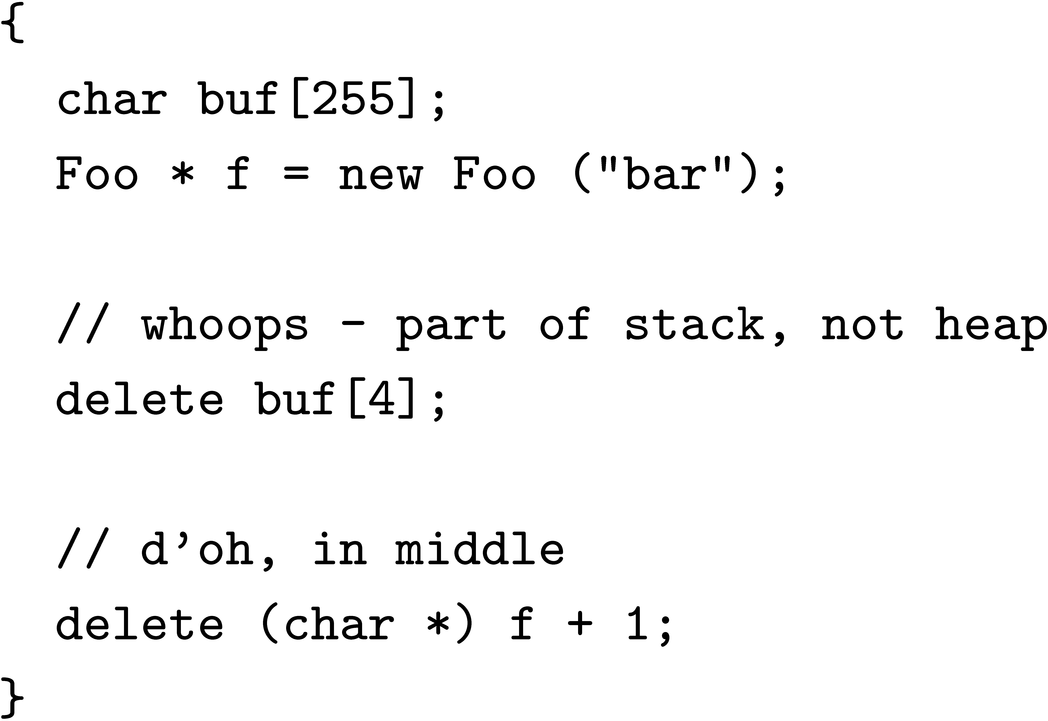
Invalid free

Slide 60
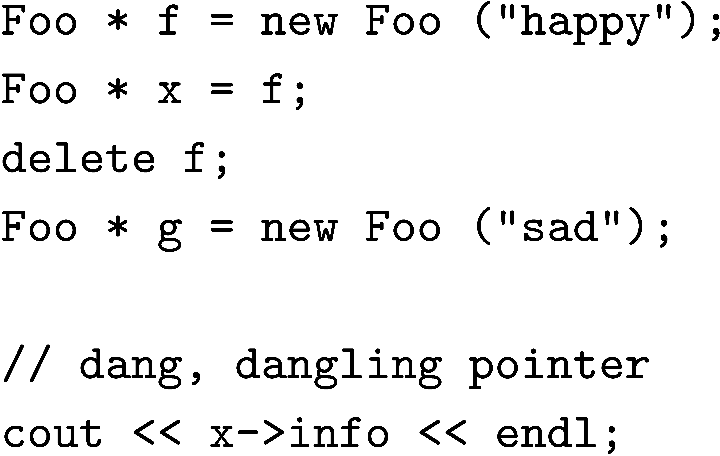
Dangling Pointer

Slide 61
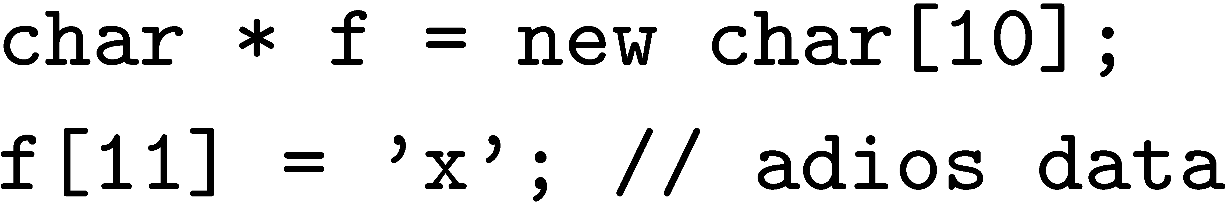
Buffer Overflows: Data Corruption
object
object
x
Bug corrupts application data

Slide 62
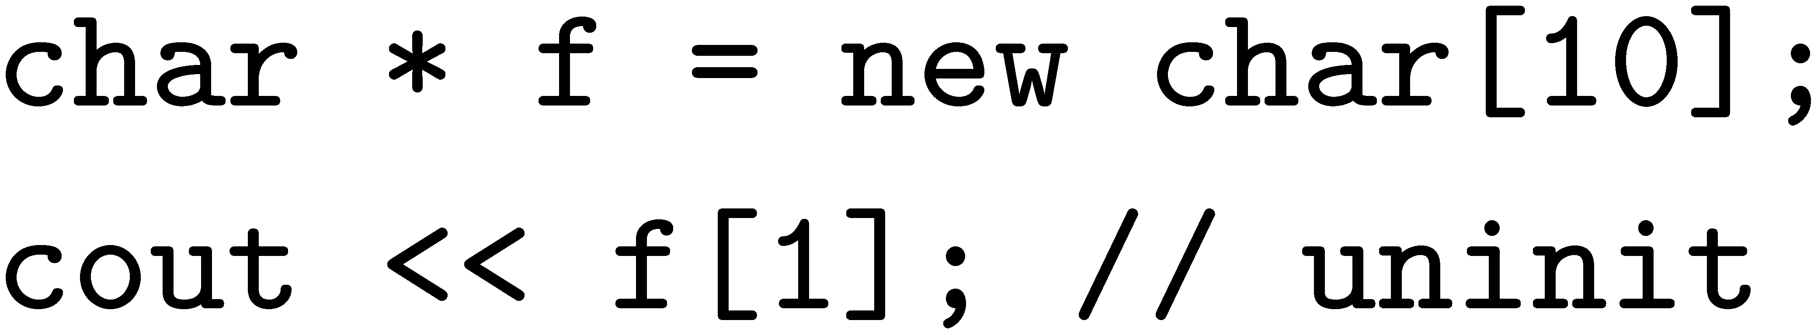
Uninitialized Reads
object
free space
C/C++ standard – undefined value

Slide 63
DieHard, heap layout
object size
allocation space
8
1
2
4
3
6
5
inUse
6
inUse
inUse
bitmap
2
4
16
1
inUse
miniheaps
1
inUse
1
Bitmap-based, segregated size classes
Bit represents one object of given size
i.e., one bit = 2^{i+3} bytes, etc.
malloc(): randomly probe bitmap for free space
free(): just reset bit

